Slide 1
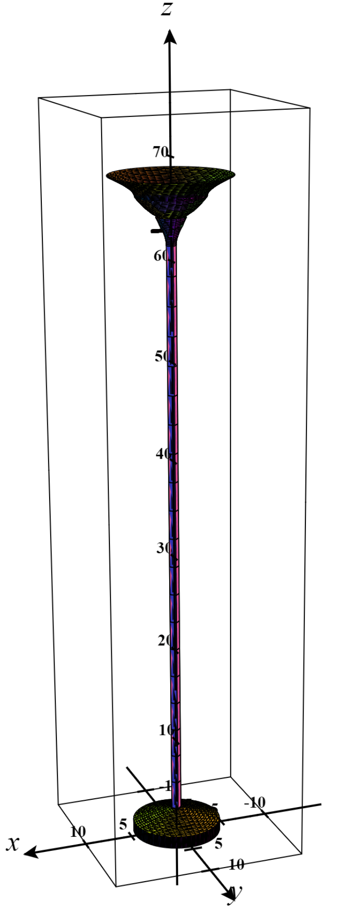
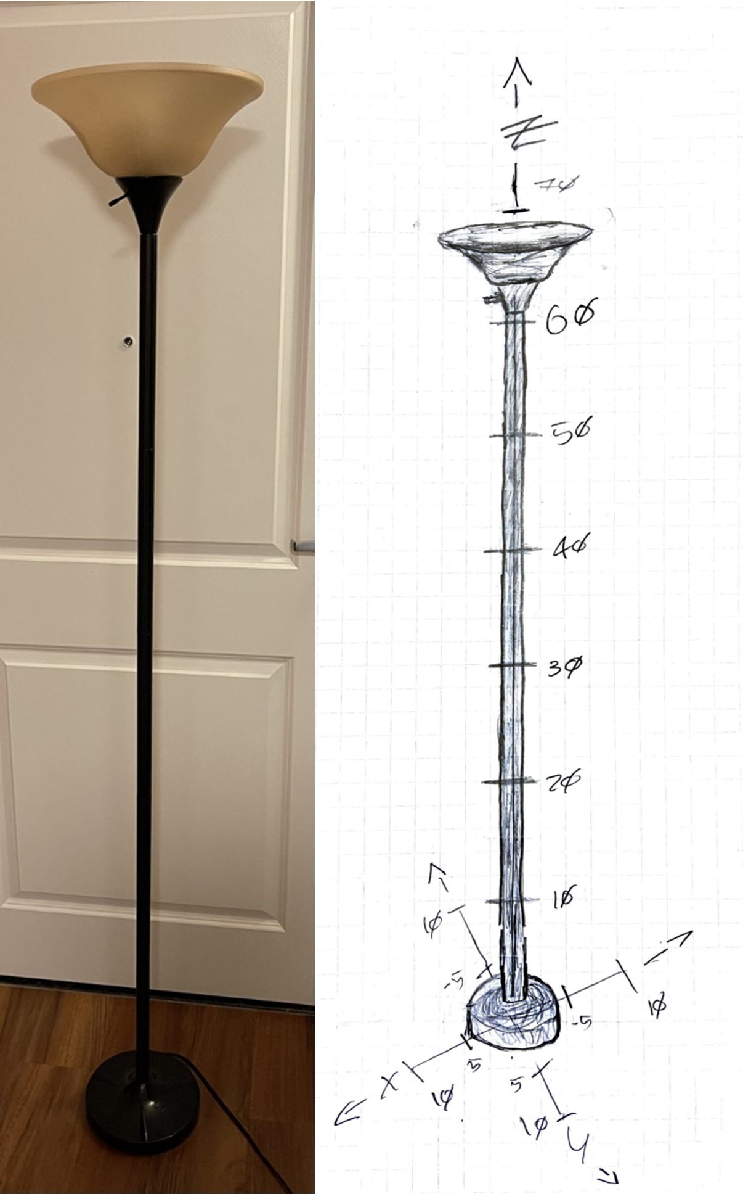
Modeling a Real-World Object with Equations
David R. Treadwell IV | MATH& 254 – Calculus IV | Liangmin Zhou |
Problem Overview
Final Figure
Math Equations (with z-ranges)
For our Calculus IV class, we were tasked with re-creating an object using only quadric surfaces, which are figures that resemble conic sections in the third dimension. This refers to shapes such as cylinders, ellipsoids, and hyperboloids.
I used a lamp as the focus-object for my project and modelled it using cylinders, hyperboloids of one sheet, and an elliptic paraboloid. I used the measurements of each individual component of the lamp to solve equations for the shapes that composed them, then input these equations on the website CalcPlot3D to plot the image.
If you would like to view my project in its entirety, please follow the link below. I hope you enjoy!
tinyurl.com/DavidTCalculus4
Base (cylinder):
$$x^{2}+y^{2}={\left(\frac{9}{2}\right)}^{2},| 0≤z≤ \frac{5}{4}$$
Base (hyperboloid one sheet):
$$\frac{x^{2}}{{\left(\frac{1}{2}\right)}^{2}}+\frac{y^{2}}{{\left(\frac{1}{2}\right)}^{2}}−\frac{{\left(z−\frac{5}{2}\right)}^{2}}{{\left(\sqrt{\frac{5}{256}}\right)}^{2}}=1 | 0≤z≤ \frac{5}{2}$$
Body (cylinder):
$$x^{2}+y^{2}={\left(\frac{1}{2}\right)}^{2} |\frac{5}{2}≤z≤ \frac{123}{2}$$
Lamp-shade support (hyperboloid one sheet):
$$\frac{x^{2}}{{\left(\frac{1}{2}\right)}^{2}}+\frac{y^{2}}{{\left(\frac{1}{2}\right)}^{2}}−\frac{{\left(z−\frac{123}{2}\right)}^{2}}{{\left(\sqrt{\frac{121}{128}}\right)}^{2}}=1 |\frac{123}{2}≤z≤ \frac{257}{4}$$
Bottom half lamp-shade (elliptic paraboloid)
$$\frac{x^{2}}{\frac{49}{9}}+\frac{y^{2}}{\frac{49}{9}}=z−64 | \frac{257}{4}≤z≤\frac{265}{4}$$
Upper half lamp-shade (hyperboloid one sheet):
$$\frac{x^{2}}{{\left(\frac{3}{2}\right)}^{2}}+\frac{y^{2}}{{\left(\frac{3}{2}\right)}^{2}}−\frac{{\left(z−\frac{257}{4}\right)}^{2}}{{\left(\sqrt{\frac{2304}{2257}}\right)}^{2}}=1 |\frac{257}{4}≤z≤ \frac{273}{4}$$
Light-switch (cylinder):
$$x^{2}+y^{2}={\left(\frac{9}{2}\right)}^{2} | 63−\frac{\sqrt{\frac{1}{2}}}{4} ≤z≤63+ \frac{\sqrt{\frac{1}{2}}}{4}$$
Original Object and Manual Sketch
Reflection
The biggest takeaway from this project was reinforcing the importance of reducing a larger task into smaller steps. The project’s goal was simple: to model an object using quadric surfaces, but so often in mathematics courses the problem is more defined, (e.g., variables are provided, the shapes are provided, etc.) and does not lend itself to as much abstract thinking.
This project forced me to think creatively about what objects I owned that were both well-suited to modeling with these equations and complicated enough to provide a challenge. From there, I needed to determine the shapes that comprised the lamp and create a set of miniature problems to solve (the equation of each component). To me, this is an extremely useful skill to build, and I am happy I could expand upon my abilities in both mathematics and creative-thinking through this project.

